Slide 1

Table, Insert, Select, Update, Delete and Upsert

Slide 2
Psql commands
psql is a terminal-based front-end to PostgreSQL. It enables you to type in queries interactively, issue them to PostgreSQL, and see the query results.
\d table_name -> shows metadata of a table
\dt -> shows tables list of connected database

Slide 3
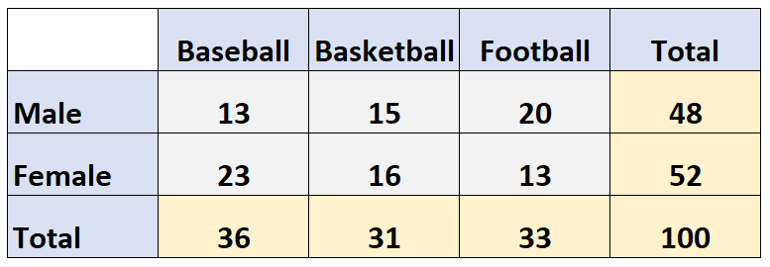
Tables
The data in an RDBMS is stored in database objects which are called as tables. This table is basically a collection of related data entries and it consists of numerous columns and rows.
Rows per table - 4,294,967,295
columns per table - 1600
limits

Slide 4
PostgreSQL Table Structure
CREATE TABLE [IF NOT EXISTS] table_name (
column1 datatype(length) column_constraint,
column2 datatype(length) column_constraint,
column3 datatype(length) column_constraint,
table_constraints
);

Slide 5
Constraints
NOT NULL – ensures that values in a column cannot be NULL.
UNIQUE – ensures the values in a column unique across the rows within the same table.
PRIMARY KEY – a primary key column uniquely identify rows in a table. A table can have one and only one primary key. The primary key constraint allows you to define the primary key of a table.
CHECK – a CHECK constraint ensures the data must satisfy a boolean expression.
FOREIGN KEY – ensures values in a column or a group of columns from a table exists in a column or group of columns in another table. Unlike the primary key, a table can have many foreign keys

Slide 6
INSERT statement
Insert is a widely-used command in data manipulation language (DML) used by relational databases. The insert command is used for inserting one or more rows into a database table with specified table column values.
INSERT INTO table_name(column1, column2, …) VALUES (value1, value2, …); RETURNING column1, column2…
INSERT INTO table_name (column_list) VALUES
(value_list_1),
(value_list_2),
...
(value_list_n)
RETURNING * | output_expression as new_name;

Slide 7
SELECT statement
Select command is used to fetch the data in a set of records from a table, view or a group of tables, views by making use of SQL joins. Retrieval of data using SQL statements can be done by using different predicates like − Where. Group By. Having.
SELECT [ ALL | DISTINCT | DISTINCT ON (distinct_expressions) ]
expressions
FROM tables
[WHERE conditions]
[GROUP BY expressions]
[HAVING condition]
[ORDER BY expression [ ASC | DESC | USING operator ] [ NULLS FIRST | NULLS LAST ]]
[LIMIT [ number_rows | ALL]
[OFFSET offset_value [ ROW | ROWS ]]
[FETCH { FIRST | NEXT } [ fetch_rows ] { ROW | ROWS } ONLY]
[FOR { UPDATE | SHARE } OF table [ NOWAIT ]];

Slide 8
UPDATE statement
Update command is a data manipulation command (DML) which is used to edit the records of a table. It may be used to update a single row based on a condition, all rows or set of rows based on the condition given by the user.
UPDATE table_name
SET column1 = value1,
column2 = value2,
…
WHERE condition
RETURNING * | output_expression AS output_name;

Slide 9
DELETE statement
Delete command is a data manipulation command(DML) which is used to remove records from a table. All records may be removed in one go, or a set of records may be deleted based on a condition.
DELETE FROM table_name
WHERE condition
RETURNING (select_list | *)

Slide 10
UPSERT statement
The term upsert is a portmanteau – a combination of the words “update” and “insert.” In the context of relational databases, an upsert is a database operation that will update an existing row if a specified value already exists in a table, and insert a new row if the specified value doesn't already exist.
INSERT INTO table_name(column_list)
VALUES(value_list)
ON CONFLICT target action;
target
(column_name) - a column name.
ON CONSTRAINT constraint_name - where the constraint name could be the name of the UNIQUE constraint.
WHERE predicate - a WHERE clause with a predicate.
action
DO NOTHING means do nothing if the row already exists in the table.
DO UPDATE SET column_1 = value_1, .. WHERE condition - update some fields in the table.

Slide 11
Interview Questions

